Slide 1
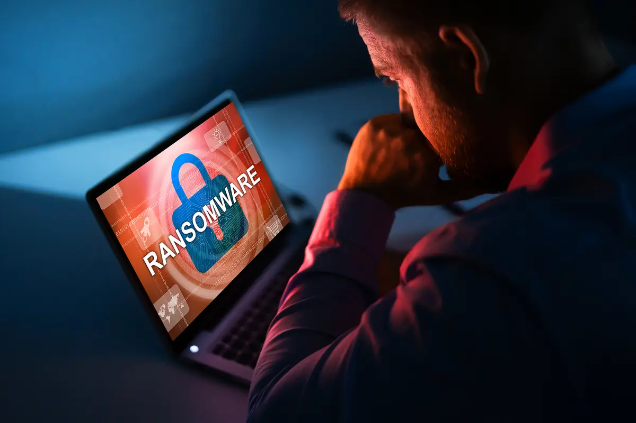
Ransomware Prevention

Slide 2
Introduction
Hello and welcome, my name is Justin Bergman and Today I will be talking about the risks of ransomware attacks and the potential threat it poses to businesses.
In this presentation The ACME Board of Directors have requested me to implement an appropriate solution to harden the security of their infrastructure and customer data.
Throughout this talk we will touch on the benefits of these security trends, concerns for them and how utilizing these tools will positively impact your customer base.

Slide 3
Overview
As the world of technology grows, so should the cyber securities practices that protect them. Having a ransomware defence strategy should be a priority for any individual or company. Without it, poorly protected users and organizations can put themselves at risk of losing important and confidential information.
A report from Cybersecurity Ventures estimates that there was one ransomware attack every 11 seconds in 2021, resulting in almost $20 billion in damages. These extortion schemes often target individuals or businesses that are most likely to pay the demanded sum to recover their data.
For many companies, that data is the most valuable asset they own. Losing it could mean irreversible damages that could cripple an entire operation. It's important to stay proactive with the best ransomware protection practices before potential threats have the opportunity to take advantage. Keep reading to learn more on how you can protect your data from any future attacks!

Slide 4
Overview
What Is Ransomware?
Ransomware is a sophisticated type of malware that can infect a computer and subsequently hold sensitive data or personally identifiable information hostage until a fee, or "ransom" is paid. Cybercriminals often use a binary encryption key to restrict data access to extort money from victims.
Ransomware attacks can be especially dangerous for businesses, hospitals, schools, or other organizations that rely on that information to function daily. In most cases, failure to pay the ransom can lead to permanent loss or exposure of confidential data.
Some of the most common ways people being infected by malware are:
Phishing emails
Visiting corrupted websites
Downloading infected file extensions or malicious attachments
System and network vulnerabilities
Remote desktop protocol (RDP) attacks
Types Of Ransomware
Ransomware attacks can affect anyone, from individual users to large corporations. This type of malware can lock up individual files, like documents or images, to entire databases, leading to huge data breaches or exposure of sensitive, personal information.
There are four main categories of ransomware:
Encryption - Encryption is the most common type of ransomware, which encrypts data and makes it impossible to unlock without a decryption key.
Lockers - Lockers restrict the use of your computer, making it impossible to work or use basic functions until the ransom is paid.
Scareware - Scareware attempts to scare users into buying unnecessary software. In some cases, pop-ups will flood the screen, forcing the user to pay to remove them.
Doxware/Leakware - Doxware or leakware will threaten to leak personal or company information unless the fine is paid.

Slide 5
Recommended Trends used to prevent Ransomware Attacks
1. Backup Your Data
Backing up your data to an external hard drive or cloud server is one of the easiest risk mitigation practices. In the case of a ransomware attack, the user can wipe the computer clean and reinstall the backup files. Ideally, organizations should be backing up their most important data at least once per day.
A popular approach to follow is the 3-2-1 rule. Try to keep 3 separate copies of your data on 2 different storage types with 1 copy offline. You can also add another step to the process by adding one more copy on an immutable (can't be altered), indelible (can't be deleted) cloud storage server.

Slide 6
Recommended Trends used to prevent Ransomware Attacks
2. Keep All Systems And Software Updated
Always keep your operating system, web browser, antivirus, and any other software you use updated to the latest version available. Malware, viruses, and ransomware are constantly evolving with new variants that can bypass your old security features, so you'll want to make sure everything is patched and up-to-date.
Many attackers prey on larger businesses that rely on outdated legacy systems that have not been updated for some time. Perhaps the most infamous ransomware attack occurred in 2017 when the malicious software “WannaCry” crippled major corporations around the world. It even forced NHS hospitals in Great Britain, Spanish telecommunications company Telefónica, and Apple chip supplier Taiwan Semiconductor Manufacturing Co. (TSMC) to shut down operations for four days. In total, over 230,000 computers globally were affected.
The attack targeted computers with outdated versions of Microsoft Windows. Despite a recently released patch that would have prevented the spread of malware, many users and organizations were slow to update and, as a result, became victims of the scam. Since this incident, security experts worldwide have urged companies to update their systems as soon as possible.

Slide 7
Recommended Trends used to prevent Ransomware Attacks
3. Install Antivirus Software & Firewalls
Antivirus and anti-malware software are the most common ways to defend against ransomware. They can scan, detect, and respond to cyber threats. However, you'll also need to configure your firewall since antivirus software only works at the internal level and can only detect the attack once it is already in the system.
Firewalls are often the first line of defence against any incoming, external attacks. It can protect against both software and hardware-based attacks. Firewalls are essential for any business or private network because they can filter out and block suspicious data packets from entering the system.

Slide 8
Recommended Trends used to prevent Ransomware Attacks
4. Network Segmentation
Because ransomware can spread quickly throughout a network, it's important to limit the spread as much as possible in the event of an attack. Implementing network segmentation divides the network into multiple smaller networks so the organization can isolate the ransomware and prevent it from spreading to other systems.
Each individual subsystem should have its own security controls, firewalls, and unique access to prevent ransomware from reaching the target data. Not only will segmented access prevent the spread to the main network, but it will also give the security team more time and identify, isolate, and remove the threat.

Slide 9
Recommended Trends used to prevent Ransomware Attacks
5. Email Protection
Historically, email phishing attacks are the leading cause of malware infections. In 2020, 54% of managed service providers (MSP) reported phishing as the top ransomware delivery method. Another report released by the Federal Bureau of Investigation (FBI) listed phishing scams as the top cybercrime in 2020, resulting in over $4.2 billion in loss or theft.
There are a couple of different ways that ransomware can infect a user through email:
Downloading suspicious email attachments
Clicking on links that lead to infected websites
Social engineering (tricking users into exposing sensitive information)
In addition to antivirus software, you can take additional precautions by using practices or technologies like:
Don't open emails from unknown senders - Avoid clicking on attachments, files, or links from unknown addresses or unauthorized sources.
Keep email client apps updated - Don't allow cybercriminals to take advantage of security vulnerabilities from out-of-date technology.
Sender Policy Framework (SPF) - Email authentication technique to designate specific email servers from which outgoing messages can be sent.
DomainKeys Identified Mail (DKIM) - Provides encryption key and digital signature to verify the email was not forged, or altered.

Slide 10
Recommended Trends used to prevent Ransomware Attacks
6. Application Whitelisting
Whitelisting determines which applications can be downloaded and executed on a network. Any unauthorized program or website that is not whitelisted will be restricted or blocked in the case an employee or user accidentally downloads an infected program or visits a corrupted site. Using whitelisting software like Windows AppLocker, you can also "blacklist" or block specific programs and websites.

Slide 11
Benefits for ACME and Customers
When your customers find out that ACME is taking the appropriate measures to prevent and protect them from malicious Ransomware attacks, they will feel safe and secure and more likely to invest or buy products related to ACME. Resulting in revenue increases for ACME and significantly reduces the risk of losing paying customers due to security risks. The customers will have peace of mind when shopping or investing that their sensitive information will not be leaked or hacked and then sold on to malicious users for profit.
Following these trends will protect the business but more importantly help retain and grow your customer base.

Slide 12
Concerns when not using these security trends
The risks for not using these security trends can be detrimental for your business and customer base. Negative outcomes range from losing profits to full bankruptcy and closure of the business. The average ransomware cost is $4.54 million.
Some “Real World” examples of what can happen to your business if security is not used.
McDonald's had 500 GB of data stolen in a ransomware attack. Snatch, a Russia-linked hacker group claimed to have stolen 500 GB of data from the McDonald's Corporation's Chicago headquarters. The group posted a demand on the dark web for an undisclosed amount.
Ransomware group Lapsus$ leaks password hashes for Nvidia employees. In February 2022, Nvidia announced that it was investigating an incident that compromised its systems for two days. The Lapsus$ ransomware gang claimed responsibility for leaking password hashes for Nvidia's employees and threatened to leak 1TB of additional stolen data, such as source code and information related to RTX GPUs
Toyota Motor Corp. suspended the operation of 28 lines at 14 plants in Japan due to an attack targeting a supplier. A supplier of plastic parts and electronic components was hit by a ransomware attack in early 2022, forcing Toyota to suspend operations of 14 plants in Japan, accounting for approximately one-third of Toyota's global production and causing a loss in output of about 13,000 vehicles.
Companies try not to expose how much was paid to the ransomware gangs but with the average estimate of $4.54 million, it’s safe to say it can equate to tens of millions of dollars worth of damage over time.

Slide 13
Conclusion
So, to conclude this presentation I will touch on what we have covered. We have covered 6 trends to help protect ACME and their customers from ransomware attack (We highly Recommend taking these precautions)
1. Backup Your Data
2. Keep All Systems And Software Updated
3. Install Antivirus Software & Firewalls
4. Network Segmentation
5. Email Protection
6. Application Whitelisting
The benefits for ACME and their customer base
And the concerns for businesses not following these security trends
So, if growing your business and generating profits is what you're looking for, look no further than what has been presented today. If you can remember one thing from this presentation, remember this, Cybercrime will Cost The World $10.5 Trillion Annually By 2025
Thank you for listening to my presentation

